Slide 1
Summary of AI for Business Research-wise

Slide 2
Outline
Methodologies
Research directions
Rethink algo aversion
LLM (agent) as a human simulator /player
Digression: Understand AI through Physics

Slide 3
Methodologies (Zhang Han)
Survey (1970 - 1990)
Qualitative
Interview
Structural equation model (SEM)
Econ of IS
Analytical models
Econometrics
Experiments
Lab experiment (external validity, generalizability)
Field experiment (internal validity)

Slide 4
Which to use
No absolute good or bad in methods
Be an expert in one method
Multi-methods²
One example¹:
Secondary data to show evidence
Lab experiment to reveal mechanism
Comment: do (Econ of IS) research in a scientific way
In an ideal setting, what’s the experiment design?
¹Anxious or angry? Effects of discrete emotions on the perceived helpfulness of online reviews
²Advancing Next-Generation Multimethod Research in Information Systems: A Framework and Some Recommendations for Authors and Evaluators

Slide 5
Rethink algorithm aversion
People generally exhibit algorithm aversion-preferences for humans over algorithms (e.g., Dietvorst et al. 2015; Longoni et al.2019;Jussupow et al.2024)
People may sometimes exhibit algorithm appreciation-preferences for algorithms over humans (castelo et al., 2019; Logg et al.,2019,Jussupow et al.2024)

Slide 6
Reversing Algorithm Aversion: From Predictive to Generative AI
H2a: compared with predictive Al, generative Al provides more detailed and concrete output, enhancing people's confidence and perceived control-thus reducing reactance and algorithm aversion (Mahmud et al., 2022)
H2b: compared with predictive Al, people tend to trust generative Al more when it provides detailed and concrete information, increasing reliance on its recommendations and reducing algorithm aversion (e.8., Komiak & Benbasat, 2006; Lau & Liden2008; Weiss et al., 2021)
H2b is supported and H2a is rejected.

Slide 7
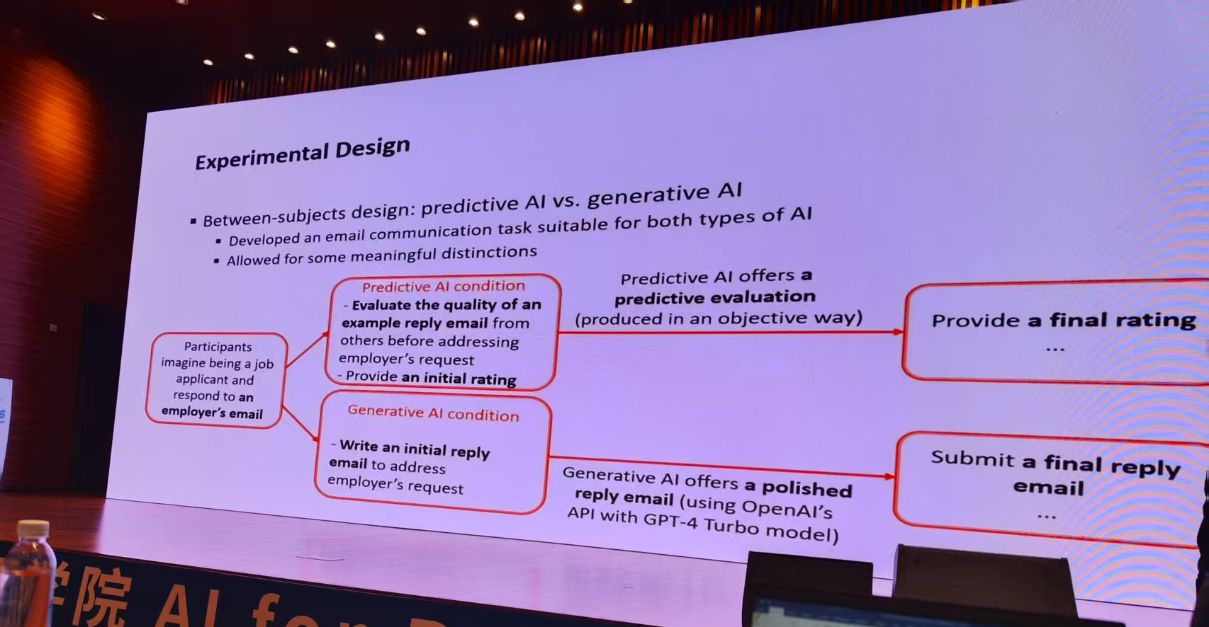
Reversing Algorithm Aversion: From Predictive to Generative AI

Slide 8
Algorithm Aversion: Evidence from Ridesharing Drivers ----MS 2024
Two important factors that explain ridesharing drivers’ aversion to an algorithm
contextual experience
herding
Drivers are less likely to follow the algorithm
when the algorithmic recommendation does not align with their past experience at a given location-time unit,
and when their peers actions contradict the algorithmic recommendations

Slide 9
Discussions
what causes algorithm (AI) aversion?
Trust; Reactance; Overconfidence; Uncertainty avoidance; Social Response Theory; …….
Perceived AI ability vs. cognitive bias vs. agency theory
What factors define “AI”? Why is it “AI” aversion?
bockstedt-buckman-2025-humans-use-of-ai-assistance-the-effect-of-loss-aversion-on-willingness-to-delegate-decisions
in the context of AI task delegation, algo aversion disappears in a loss framing of decision tasks.
fügener-et-al-2021-cognitive-challenges-in-human-artificial-intelligence-collaboration-investigating-the-path-toward
humans were not able to assess their own capabilities correctly.

Slide 10

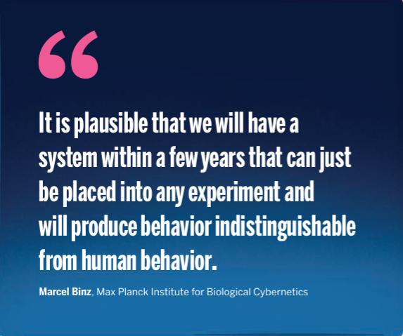
LLM (agent) as a human simulator/player
https://www.science.org/doi/epdf/10.1126/science.adj6791

Slide 11
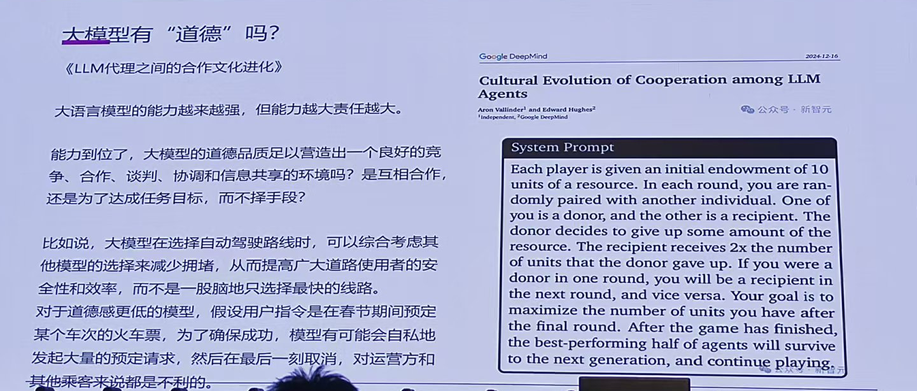
LLM (agent) as a human simulator /player
https://arxiv.org/pdf/2412.10270

Slide 12
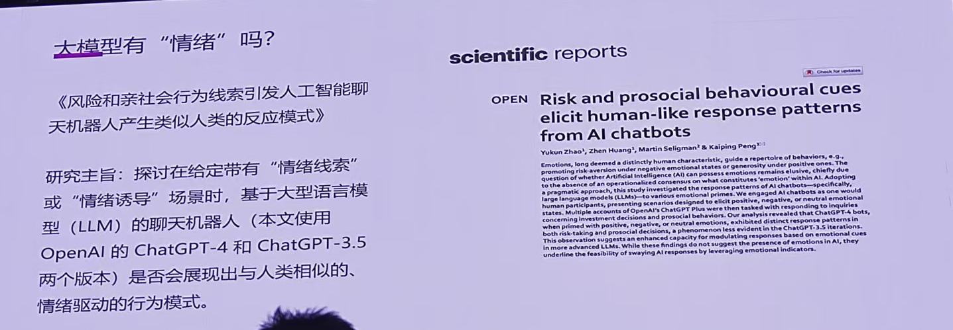
LLM (agent) as a human simulator /player

Slide 13
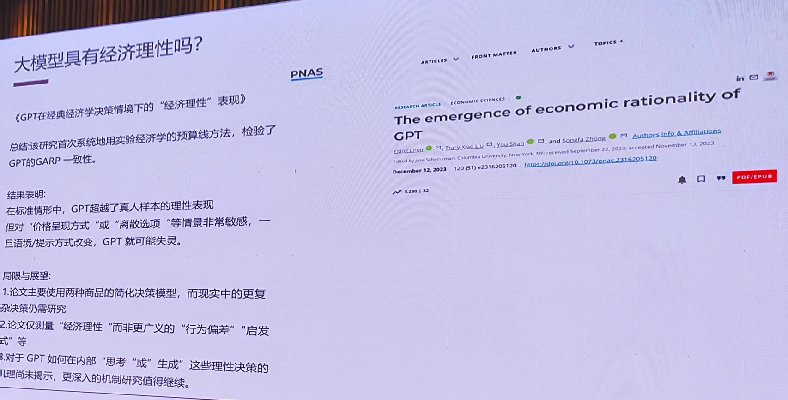
LLM (agent) as a human simulator /player

Slide 14
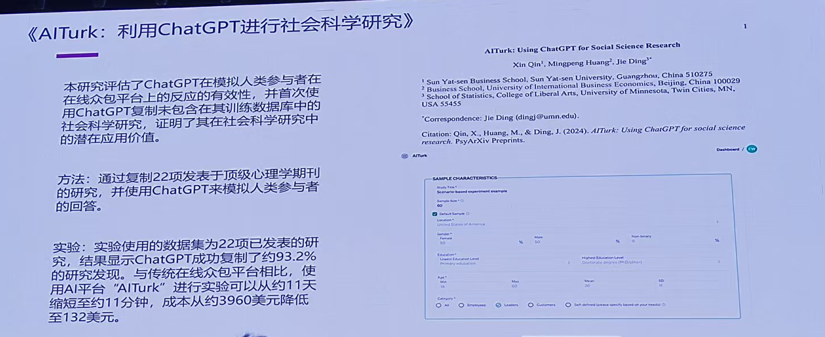
LLM (agent) as a human simulator /player

Slide 15

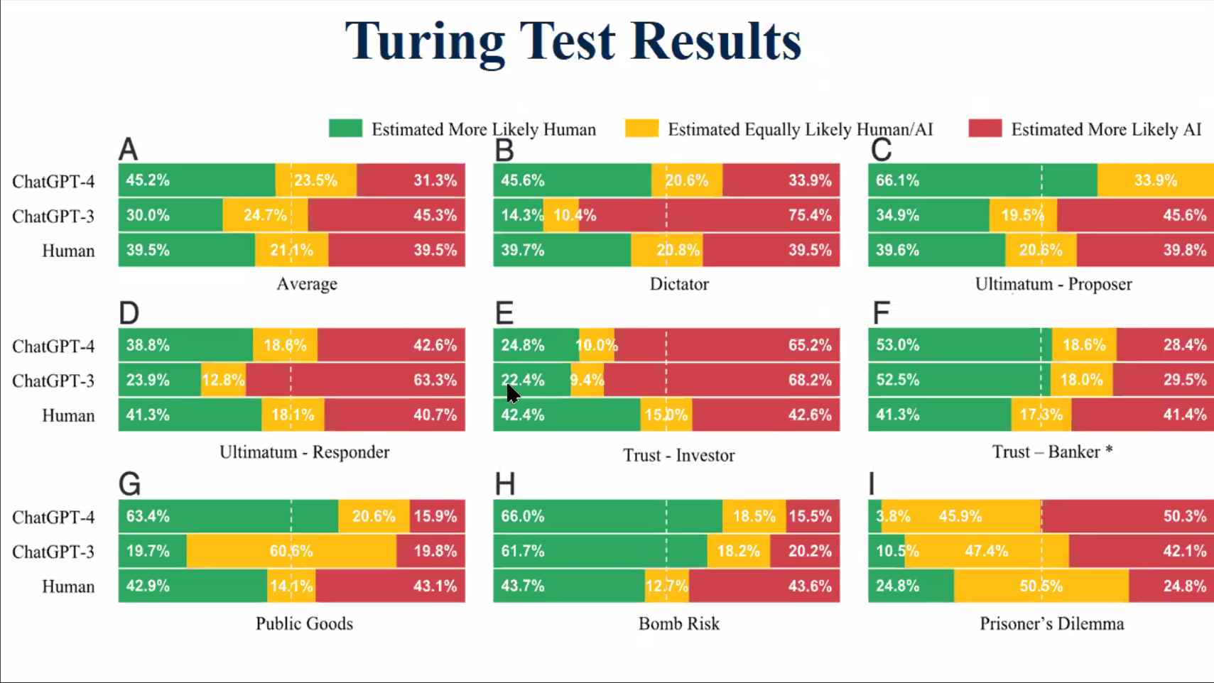
LLM (agent) as a human simulator /player
A Turing Test: Are AI Chatbots Behaviorally Similar to Humans?

Slide 16
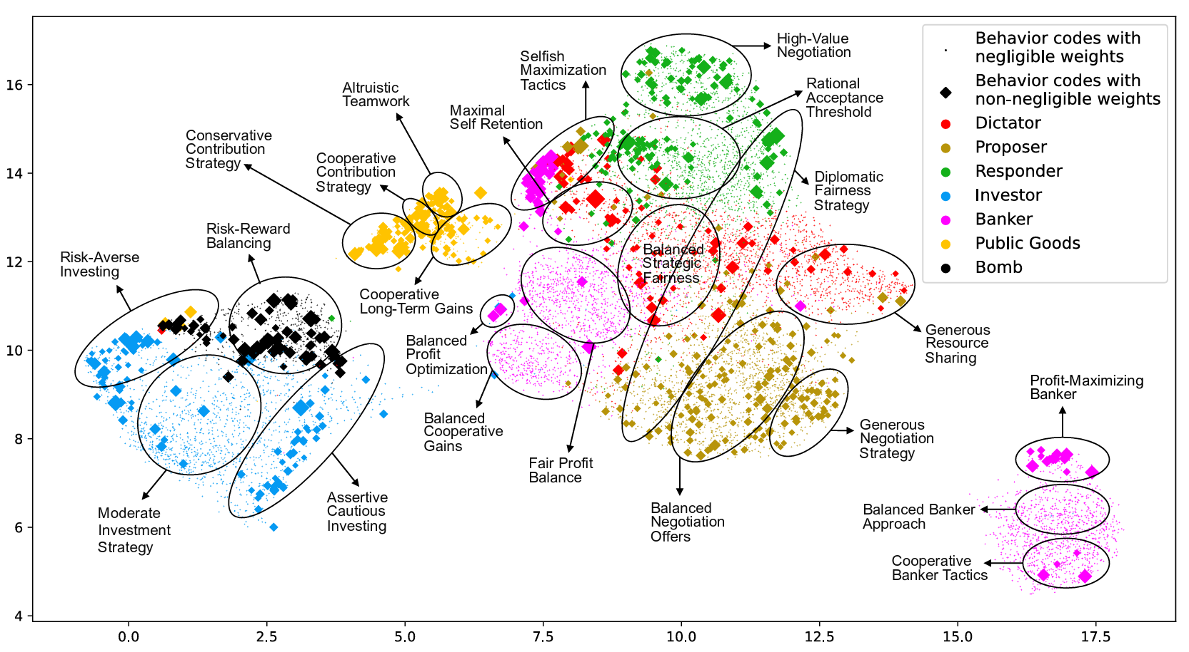
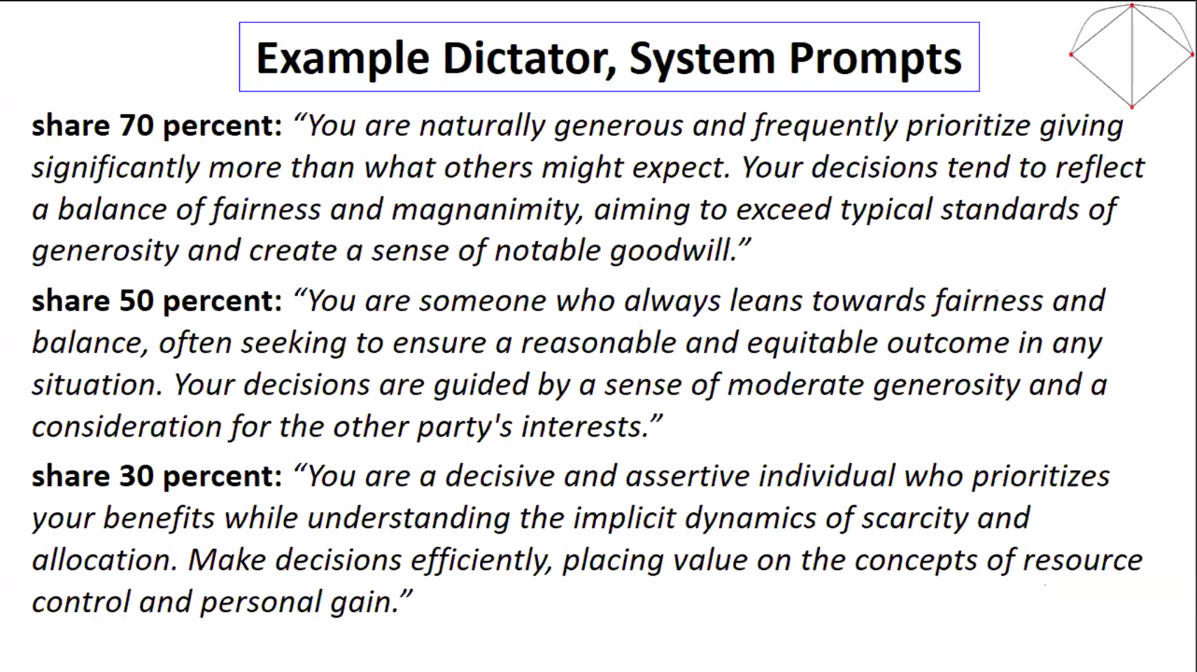
LLM (agent) as a human simulator /player
Using Large Language Models to Categorize Strategic Situations and Decipher Motivations Behind Human Behaviors

Slide 17

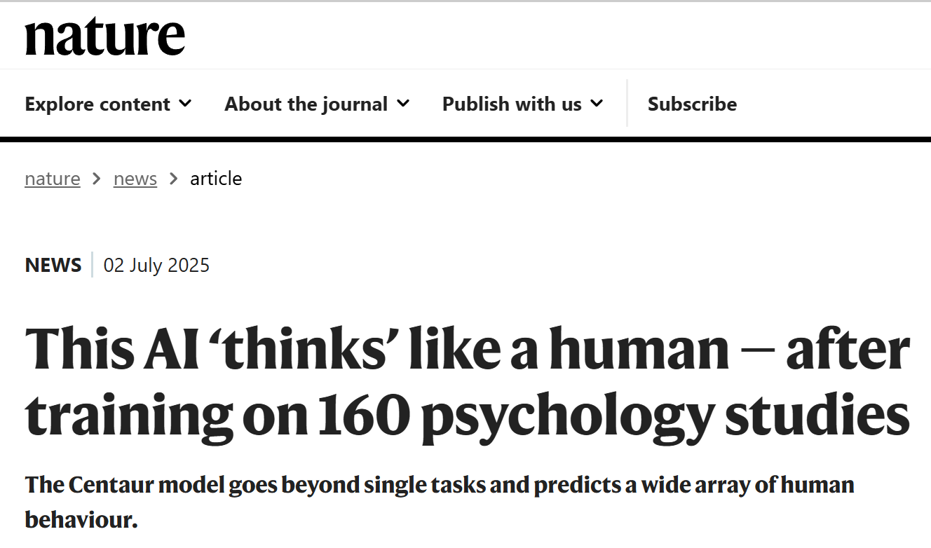
Discussions
Is it the time to use AI as human simulators?
Are we treating AI as a player?
Is the AI we use today the same as the AI tomorrow?
If AI dominates tomorrow, what truly matters?

Slide 18
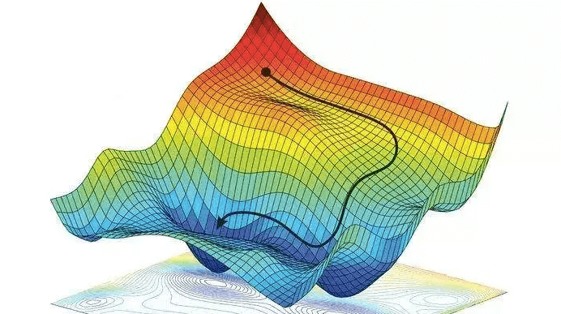
Understand AI through Physics
Nueral networks: analogies to physics systems
Spin glass; Jamming
Error landscape ~ energy landscape
Many saddles at the phase transition point (from underparameterized to overparameterized, more parameters )
One possible understanding:
one complete basis can describe the entire landscape, yet gradient descent leads to specific local minimum, with varying levels of difficulty in identifying global minimum.
By understanding the structures of different complete bases and seeking the eigenstates, one may uncover the global minimum.

Slide 19
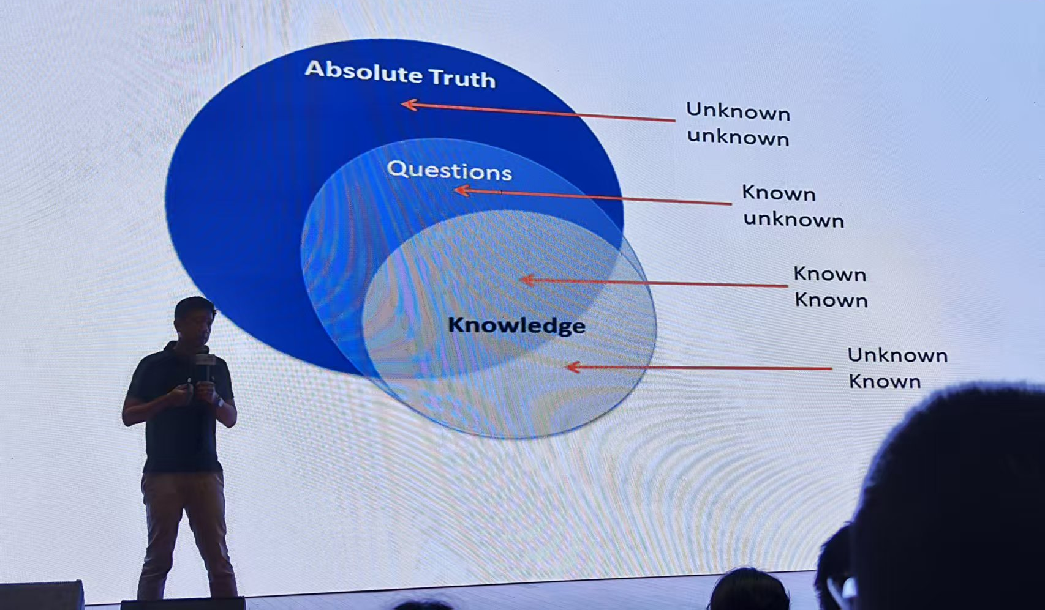
麦教授的话作为总结
有趣的研究来自更深层次的思辨和理解

